Slide 1
Superstore Sales Dashboard
Tool Used: Power BI
Dataset Source: Sample Superstore Dataset

Slide 2
Objectives
Visualize sales, profit, and discounts across regions and categories
Track monthly sales performance
Identify high and low-performing sub-categories and products
Understand discount impact on profit
Enable stakeholders to make data-driven decisions

Slide 3
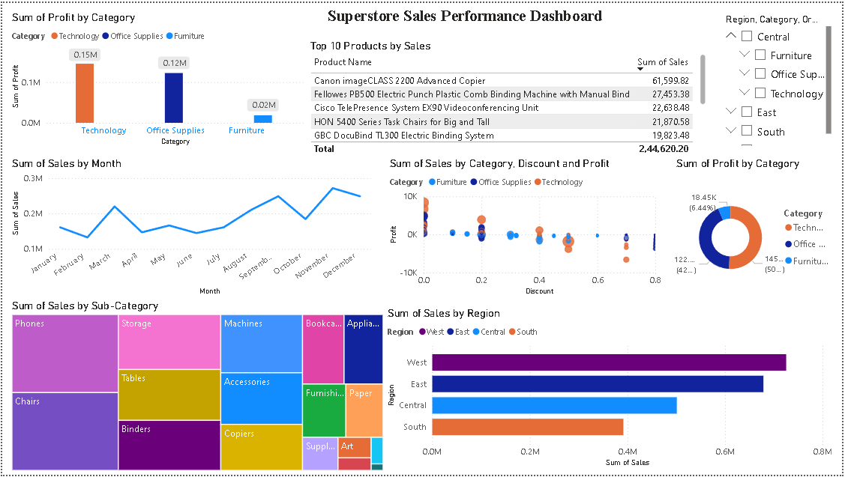
Dashboard

Slide 4
Top Insights
Technology category generates the highest profit
Sales peak during September and December
West region leads in total sales performance
Higher discounts often lead to negative profits
Phones and Chairs dominate sub-category sales

Slide 5
Conclusion
This dashboard provides a comprehensive view of sales performance across different segments.
It enables stakeholders to:
Identify areas of strength and weakness
Monitor trends and patterns over time
Make informed business decisions based on data
Optimize product offerings and pricing strategies

